Slide 1
Measurement
Topic: Volume of Complex Shapes
EQ: How do we work out the volume of complex shapes?
Mrs Stretch
Year 9

Slide 2
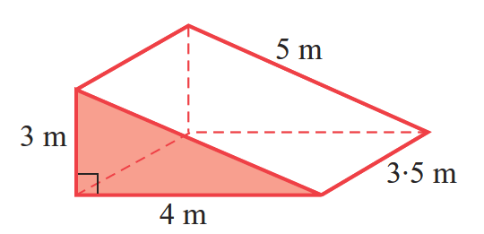
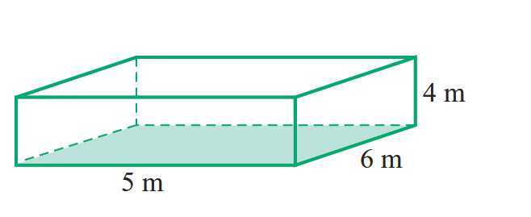
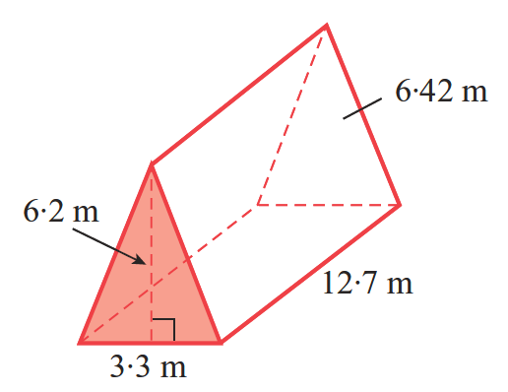
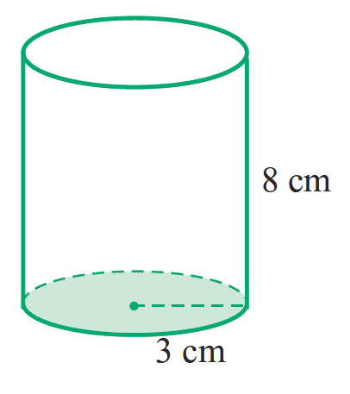
Surface Area Re-Cap
Find the S.A of the following shapes:

Slide 3
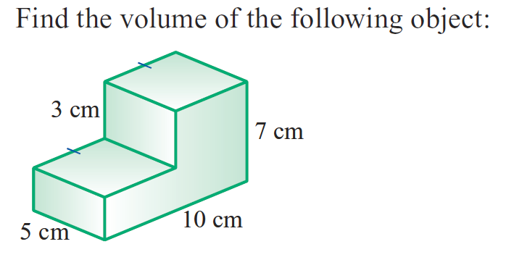


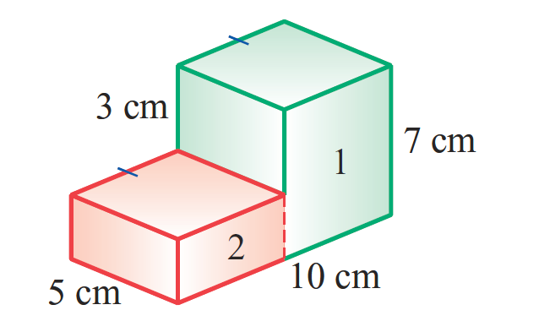

24
7
30
Volume of Complex Shapes
Date
EQ – How do we work out the volume of complex shapes?

Slide 4


Slide 5
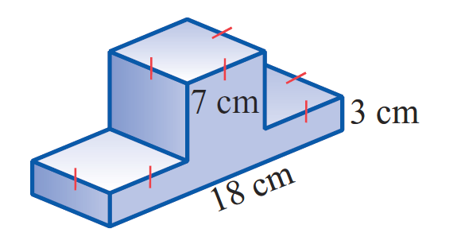
Practice

Slide 6
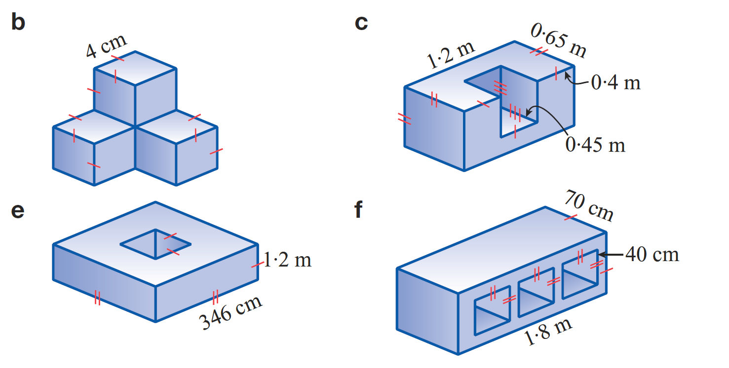
Task

